Slide 1

Project Report
Nitish Bhardwaj

Slide 2
Overview
Collect user location data and show a heat map of it.

Slide 3
Steps
Create MySQL database table.
Connect with database using PHP file.
Collect real time geolocation data and save it in a database.
Show data on a map.
Add geofence on to a map.

Slide 4
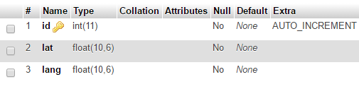
Things completed so far
Created database

Slide 5
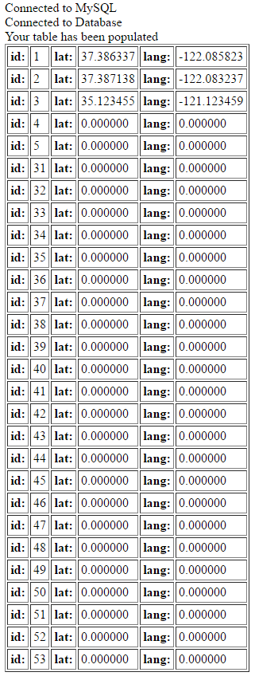
Connect database to PHP

Slide 6
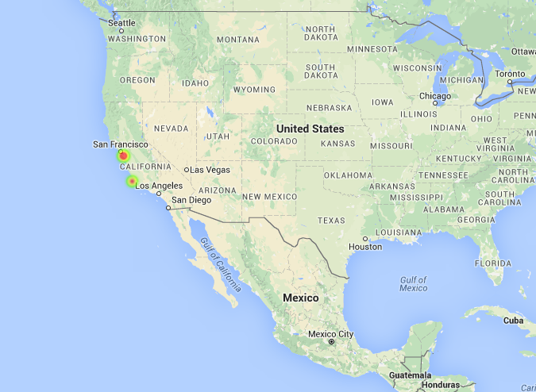
Show heat map of data

Slide 7
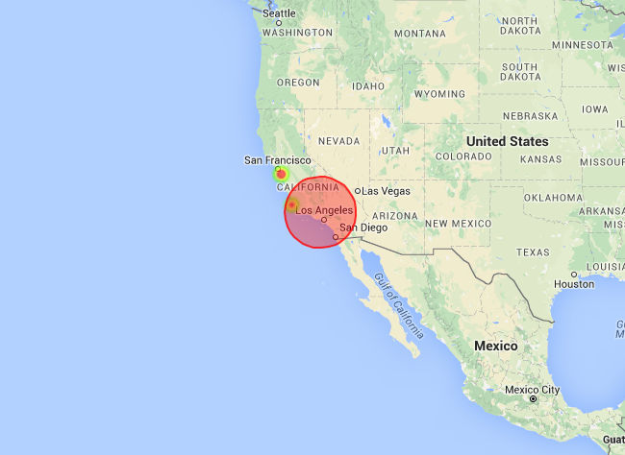
Add geo-fence

